Slide 1
Welcome to MSA Git & GitHub workshop
We will be commencing shortly
This is a Microsoft Teams Live event, so you are placed on mute for the entire duration.
If you have any questions, please select “Ask a question” or upvote by liking existing ones.
Captions can be turned on anytime by clicking the “CC” icon.
At any point where you get lost, you can rewind the live stream to any point in time.
This workshop is being recorded and all recordings can be accessed via the same link you used to access this live event.
Having this workshop being recorded, should you not consent, please feel free to leave if you wish.
For updates on the program, please join our Facebook group at https://aka.ms/MSAFacebook
We hope you enjoy the session!

Slide 2


presents
Artificial Intelligence and Analytics

Slide 3
Agenda
01
Introduction to Git & GitHub
05
Questions & Answers
02
Benefits
03
Going Beyond Just Coding
04
Hands-on Demo

Slide 4

AI & ML Concepts

Slide 5

Story Time!

Slide 6
What is Git?

Slide 7
Why Is Git So Useful

Slide 8
Image This Scenario

Slide 9
What Is GitHub

Slide 10
Making An Impact Through Open Source Contributions

Slide 11
Beating The Imposter Syndrome

Slide 12
Thank You!
Please ask any questions in the Q&A section of the Livestream

Slide 13
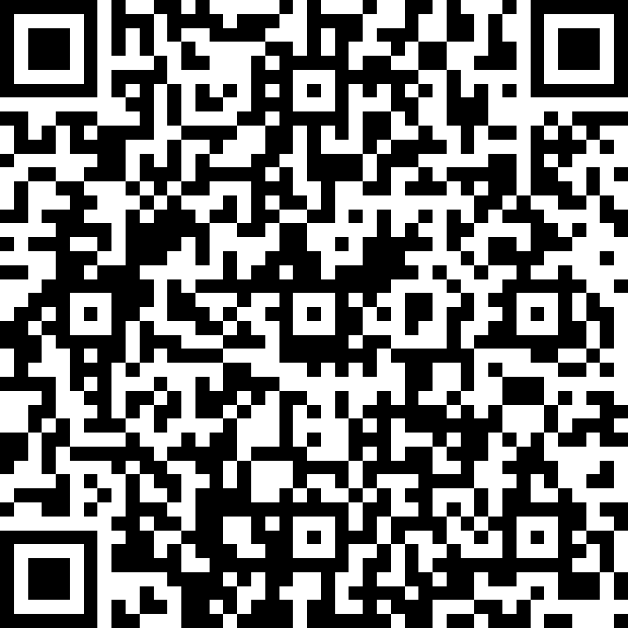
Attendance Form
https://aka.ms/AttendanceForm

Slide 14
Break
(10 mins)

Slide 15
Project walk-through

Slide 16
Project Walkthrough
A sample to teach you how to use AzureML and Azure Notebooks in your project
Uses MNIST Dataset – Predicting Handwritten digits
*If you get lost, you can always re-watch this recording later at your own pace

Slide 17
Questions and Answers

Slide 18
Thank you for attending!
The recording for this Bootcamp can be accessed via the same link used to access this live event.
All resources can be found on our GitHub repo which can be accessed via the link we sent to your email.

